Slide 1


Computer Networks
Lectures (Chapter4)
Network Layer: Data Plane
Subhan Ullah, PhD
subhan.ullah@nu.edu.pk
BS(Computer Science) Spring-2024

Slide 2
Network layer: our goals
understand principles behind network layer services, focusing on data plane:
network layer service models
forwarding versus routing
how a router works
addressing
generalized forwarding
Internet architecture
instantiation, implementation in the Internet
IP protocol
Network Address Translation (NAT)

Slide 3

Network layer: “data plane” roadmap
Network layer: overview
data plane
control plane
What’s inside a router
input ports, switching, output ports
buffer management, scheduling
IP: the Internet Protocol
datagram format
addressing
network address translation
IPv6

Slide 4
IP addresses: how to get one?
That’s actually two questions:
Q: How does a host get IP address within its network (host part of address)?
Q: How does a network get IP address for itself (network part of address)
How does host get IP address?
hard-coded by sysadmin in config file (e.g., /etc/rc.config in UNIX)
DHCP: Dynamic Host Configuration Protocol: dynamically get address from a server
“plug-and-play”

Slide 5
DHCP: Dynamic Host Configuration Protocol
goal: host dynamically obtains IP address from network server when it “joins” network
can renew its lease on address in use
allows reuse of addresses (only hold address while connected/on)
support for mobile users who join/leave network
DHCP overview:
host broadcasts DHCP discover msg [optional]
DHCP server responds with DHCP offer msg [optional]
host requests IP address: DHCP request msg
DHCP server sends address: DHCP ack msg

Slide 6





DHCP client-server scenario
Typically, DHCP server will be co-located in router, serving all subnets to which router is attached
DHCP server
223.1.1.1
223.1.2.1
223.1.2.5
223.1.1.2
223.1.1.4
223.1.2.9
223.1.1.3
223.1.3.27
arriving DHCP client needs
address in this network
223.1.2.2
223.1.3.1
223.1.3.2

Slide 7


DHCP client-server scenario
DHCP server: 223.1.2.5
DHCP discover
Arriving client
src : 0.0.0.0, 68
dest.: 255.255.255.255,67
yiaddr: 0.0.0.0
transaction ID: 654
Broadcast: is there a DHCP server out there?
DHCP offer
src: 223.1.2.5, 67
dest: 255.255.255.255, 68
yiaddrr: 223.1.2.4
transaction ID: 654
lifetime: 3600 secs
Broadcast: I’m a DHCP server! Here’s an IP address you can use
The two steps above can be skipped “if a client remembers and wishes to reuse a previously allocated network address” [RFC 2131]
DHCP request
src: 0.0.0.0, 68
dest:: 255.255.255.255, 67
yiaddrr: 223.1.2.4
transaction ID: 655
lifetime: 3600 secs
Broadcast: OK. I would like to use this IP address!
DHCP ACK
src: 223.1.2.5, 67
dest: 255.255.255.255, 68
yiaddrr: 223.1.2.4
transaction ID: 655
lifetime: 3600 secs
Broadcast: OK. You’ve got that IP address!

Slide 8
DHCP: more than IP addresses
DHCP can return more than just allocated IP address on subnet:
address of first-hop router for client
name and IP address of DNS sever
network mask (indicating network versus host portion of address)

Slide 9
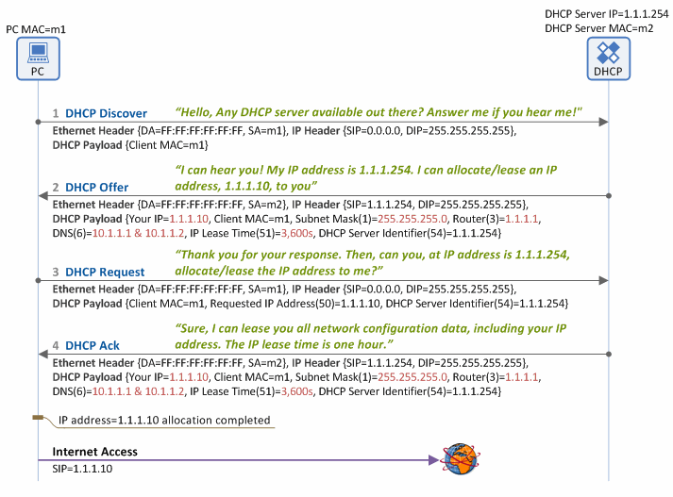
DHCP client-server (a detailed scenario)
Notes:
https://www.netmanias.com/en/?m=view&id=techdocs&no=5998
1. DHCP Discover
When a client (PC) is booted, it broadcasts a DHCP Discover message over the Ethernet network to locate all available DHCP servers on the same subnet network (by setting the destination MAC address in the Ethernet header as Broadcast MAC=FF:FF:FF:FF:FF:FF), reaching all the DHCP servers on the same subnet network.
2. DHCP Offer
When a DHCP server receives the DHCP Discover message from the client, it also broadcasts a DHCP Offer message over the Ethernet network (because the client IP address has not been allocated yet), informing the client that it is available. This message contains the network information, such as client IP address, subnet mask, default gateway IP address, DNS IP address, IP lease time and DHCP server IP address. The DHCP Offer message broadcasted is delivered to all the clients on the same subnet network, including the one that sent the DHCP Discover message.
3. DHCP Request
The client, having received the DHCP Offer message, recognizes there is a DHCP server available on the same subnet. Then it broadcasts a DHCP Request message to the server over the Ethernet network, requesting network configuration data including an IP address for itself. If more than one DHCP server responds on the same subnet and hence the client receives multiple DHCP Offer messages, it selects one of the DHCP servers, and enters the IP address of the selected DHCP server in the DHCP Server Identifier (option 54) field of the DHCP Request message. Then it informs all the DHCP servers on the subnet network about such selection by broadcasting the DHCP Request message. Typically, all DHCP servers internally store the network configuration data (i.e. IP address for the client and other information) when they send a DHCP Offer message. So, the client broadcasts the DHCP Request message to all the DHCP servers, so that those not selected can also receive the message and delete the stored network configuration data from their memory.
4. DHCP Ack
The DHCP server which received the DHCP Request message from the client checks if the IP address shown in the DHCP Server Identifier (option 54) field matches its own. If it does, it broadcasts a DHCP Ack message ensuring the client can receive the message (Note: the client has NOT been allocated an IP address yet).
At this time, the DHCP server transfers all the network configuration data including the client IP address – the same data sent along with the DHCP Offer message - to the client. Then the client configures a network interface using the transferred data, finally connecting to the Internet. The typical network configuration data includes:
IP address
Subnet mask
Default gateway IP address
DNS server IP address
Lease time (during which a client can use the IP address allocated/leased by a DHCP server)

Slide 10


DHCP: example
DHCP
DHCP
UDP
IP
Eth
Phy
Connecting laptop will use DHCP to get IP address, address of first-hop router, address of DNS server.
DHCP
DHCP
DHCP
DHCP
DHCP REQUEST message encapsulated in UDP, encapsulated in IP, encapsulated in Ethernet
DHCP
DHCP
UDP
IP
Eth
Phy
168.1.1.1
DHCP
DHCP
DHCP
Ethernet frame broadcast (dest: FFFFFFFFFFFF) on LAN, received at router running DHCP server
DHCP
router with DHCP
server built into
router
Ethernet demux’ed to IP demux’ed, UDP demux’ed to DHCP

Slide 11
DHCP: example
DHCP
UDP
IP
Eth
Phy
DCP server formulates DHCP ACK containing client’s IP address, IP address of first-hop router for client, name & IP address of DNS server
DHCP
DHCP
DHCP
DHCP
encapsulated DHCP server reply forwarded to client, demuxing up to DHCP at client
DHCP
DHCP
UDP
IP
Eth
Phy
DHCP
DHCP
DHCP
router with DHCP
server built into
router
client now knows its IP address, name and IP address of DNS server, IP address of its first-hop router
DHCP
Notes:
Covered for section D:16-12-2021

Slide 12
Network layer: “data plane” roadmap
Network layer: overview
data plane
control plane
What’s inside a router
input ports, switching, output ports
buffer management, scheduling
IP: the Internet Protocol
datagram format
addressing
network address translation (NAT)
IPv6

Slide 13
NAT: network address translation
NAT: all devices in local network share just one IPv4 address as far as outside world is concerned
rest of
Internet
local network (e.g., home network) 10.0.0.0/24
10.0.0.1
138.76.29.7
10.0.0.4
10.0.0.2
10.0.0.3
all datagrams leaving local network have same source NAT IP address: 138.76.29.7, but different source port numbers
datagrams with source or destination in this network have 10.0.0.0/24 address for source, destination (as usual)

Slide 14
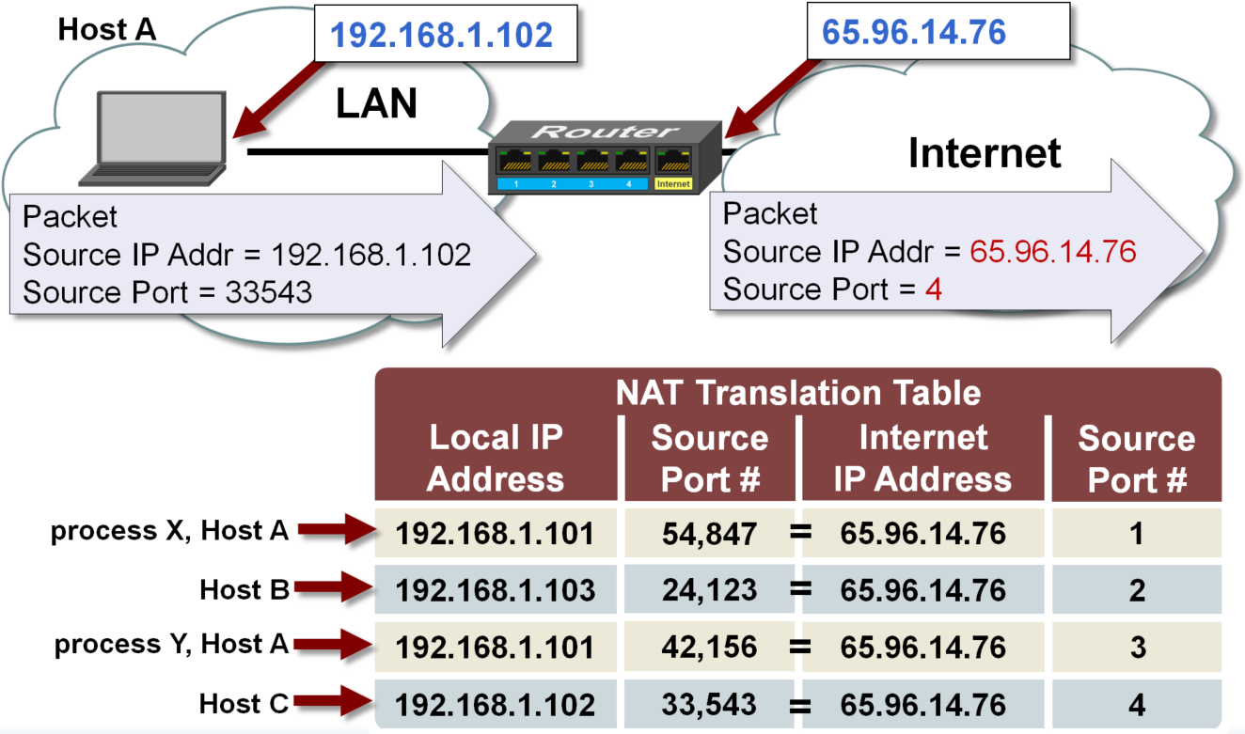
NAT Translation Table

Slide 15
NAT: network address translation
all devices in local network have 32-bit addresses in a “private” IP address space (10/8, 172.16/12, 192.168/16 prefixes) that can only be used in local network
advantages:
just one IP address needed from provider ISP for all devices
can change addresses of host in local network without notifying outside world
can change ISP without changing addresses of devices in local network
security: devices inside local net not directly addressable, visible by outside world

Slide 16
NAT: network address translation
implementation: NAT router must (transparently):
outgoing datagrams: replace (source IP address, port #) of every outgoing datagram to (NAT IP address, new port #)
remote clients/servers will respond using (NAT IP address, new port #) as destination address
remember (in NAT translation table) every (source IP address, port #) to (NAT IP address, new port #) translation pair
incoming datagrams: replace (NAT IP address, new port #) in destination fields of every incoming datagram with corresponding (source IP address, port #) stored in NAT table

Slide 17
NAT: network address translation
NAT translation table
WAN side addr LAN side addr
2: NAT router changes datagram source address from 10.0.0.1, 3345 to 138.76.29.7, 5001,
updates table
1: host 10.0.0.1 sends datagram to 128.119.40.186, 80
138.76.29.7, 5001 10.0.0.1, 3345
…… ……
S: 10.0.0.1, 3345
D: 128.119.40.186, 80
10.0.0.1
1
2
S: 138.76.29.7, 5001
D: 128.119.40.186, 80
10.0.0.4
10.0.0.2
138.76.29.7
S: 128.119.40.186, 80
D: 10.0.0.1, 3345
4
S: 128.119.40.186, 80
D: 138.76.29.7, 5001
3
10.0.0.3
3: reply arrives, destination address: 138.76.29.7, 5001

Slide 18
NAT: network address translation
NAT has been controversial:
routers “should” only process up to layer 3
address “shortage” should be solved by IPv6
violates end-to-end argument (port # manipulation by network-layer device)
NAT traversal: what if client wants to connect to server behind NAT?
but NAT is here to stay:
extensively used in home and institutional nets, 4G/5G cellular nets
Notes:
Section G and F covered: 17.12.2021

Slide 19
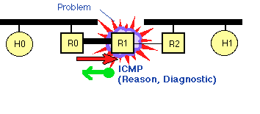
ICMP: internet control message protocol
ICMP (Internet Control Message Protocol) is an error-reporting protocol and used to report problems with the network layer.
Network devices like routers use to generate error messages to the source IP address when network problems prevent delivery of IP packets.
Any IP network device has the capability to send, receive or process ICMP messages.
for example, that a requested service is not available or that a host or router could not be reached.

Slide 20
ICMP: internet control message protocol
used by hosts & routers to communicate network-level information
error reporting: unreachable host, network, port, protocol
echo request/reply (used by ping)
network-layer “above” IP:
ICMP msgs carried in IP datagrams
ICMP message: type, code plus first 8 bytes of IP datagram causing error
Type Code description
0 0 echo reply (ping)
3 0 dest. network unreachable
3 1 dest host unreachable
3 2 dest protocol unreachable
3 3 dest port unreachable
3 6 dest network unknown
3 7 dest host unknown
4 0 source quench (congestion
control - not used)
8 0 echo request (ping)
9 0 route advertisement
10 0 router discovery
11 0 TTL expired
12 0 bad IP header

Slide 21
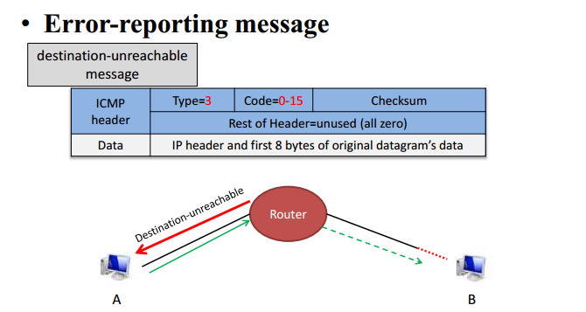
ICMP: Example

Slide 22
Traceroute and ICMP
source sends series of UDP segments to dest
first set has TTL =1
second set has TTL=2, etc.
unlikely port number
when nth set of datagrams arrives to nth router:
router discards datagrams
and sends source ICMP messages (type 11, code 0)
ICMP messages includes name of router & IP address
when ICMP messages arrives, source records RTTs
stopping criteria:
UDP segment eventually arrives at destination host
destination returns ICMP “port unreachable” message (type 3, code 3)
source stops
3 probes
3 probes
3 probes

Slide 23
IPv6: motivation
initial motivation: 32-bit IPv4 address space would be completely allocated
additional motivation:
speed processing/forwarding: 40-byte fixed length header
enable different network-layer treatment of “flows”

Slide 24
IPv6 vs. IPv4: Address Comparison
IPv4 has a maximum of
2³² ≈ 4 billion addresses
IPv6 has a maximum of
2¹²⁸ = (2³²)⁴ ≈ 4 billion x 4 billion x 4 billion x 4 billion addresses
IPv6 has a theoretical limit of 3.4 x 10³⁸ addresses
That’s over 340 undecillion addresses, which is reportedly enough addresses to assign one to every single atom on the surface of the earth
Notes:
The IPv6 has a theoretical limit of 3.4 x 10³⁸ addresses. That’s over 340 undecillion addresses, which is reportedly enough addresses to assign one to every single atom on the surface of the earth.

Slide 25
Notation of IPv6 addresses
Convention: The 128-bit IPv6 address is written as eight 16-bit integers (using hexadecimal digits for each integer)
CEDF:BP76:3245:4464:FACE:2E50:3025:DF12
Short notation:
Abbreviations of leading zeroes:
CEDF:BP76:0000:0000:009E:0000:3025:DF12 → CEDF:BP76:0:0:9E :0:3025:DF12

Slide 26
IPv6 datagram format
flow label: identify datagrams in same "flow.” (concept of “flow” not well defined).
32 bits
priority: identify priority among datagrams in flow
ver
pri
flow label
payload len
next hdr
hop limit
source address
(128 bits)
128-bit
IPv6 addresses
destination address
(128 bits)
payload (data)
What’s missing (compared with IPv4):
no checksum (to speed processing at routers)
no fragmentation/reassembly
no options (available as upper-layer, next-header protocol at router)

Slide 27
Transition from IPv4 to IPv6
not all routers can be upgraded simultaneously
no “flag days”
how will network operate with mixed IPv4 and IPv6 routers?
tunneling: IPv6 datagram carried as payload in IPv4 datagram among IPv4 routers (“packet within a packet”)
tunneling used extensively in other contexts (4G/5G)
IPv4 header fields
IPv6 header fields
IPv4 payload
IPv4 source, dest addr
IPv6 source dest addr
UDP/TCP payload
IPv6 datagram
IPv4 datagram

Slide 28
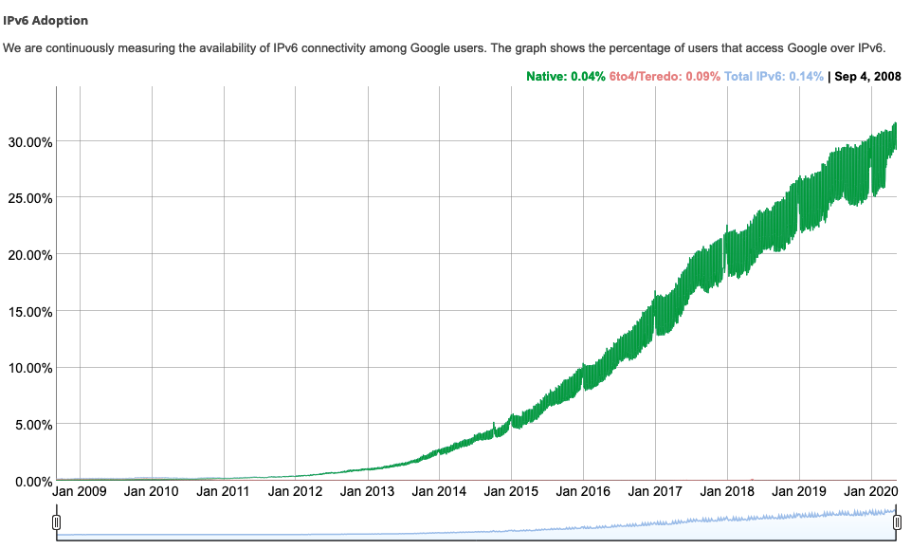
IPv6: adoption
Google¹: ~ 30% of clients access services via IPv6
NIST: 1/3 of all US government domains are IPv6 capable
¹ https://www.google.com/intl/en/ipv6/statistics.html

Slide 29
IPv6: adoption
Google¹: ~ 30% of clients access services via IPv6
NIST: 1/3 of all US government domains are IPv6 capable
Long (long!) time for deployment, use
25 years and counting!
think of application-level changes in last 25 years: WWW, social media, streaming media, gaming, telepresence, …
¹ https://www.google.com/intl/en/ipv6/statistics.html

Slide 30


Thank You All
☺
?
A note on the origin of these ppt slides:
All material copyright 1996-2020 J.F Kurose and K.W. Ross, All Rights Reserved
These slides are freely provided by the book authors and it represents a lot of work on their part. We would like to thank J.F Kurose and K.W. Ross.
Transport Layer: 3-150
Notes:
Section F and G ended

